Slide 1
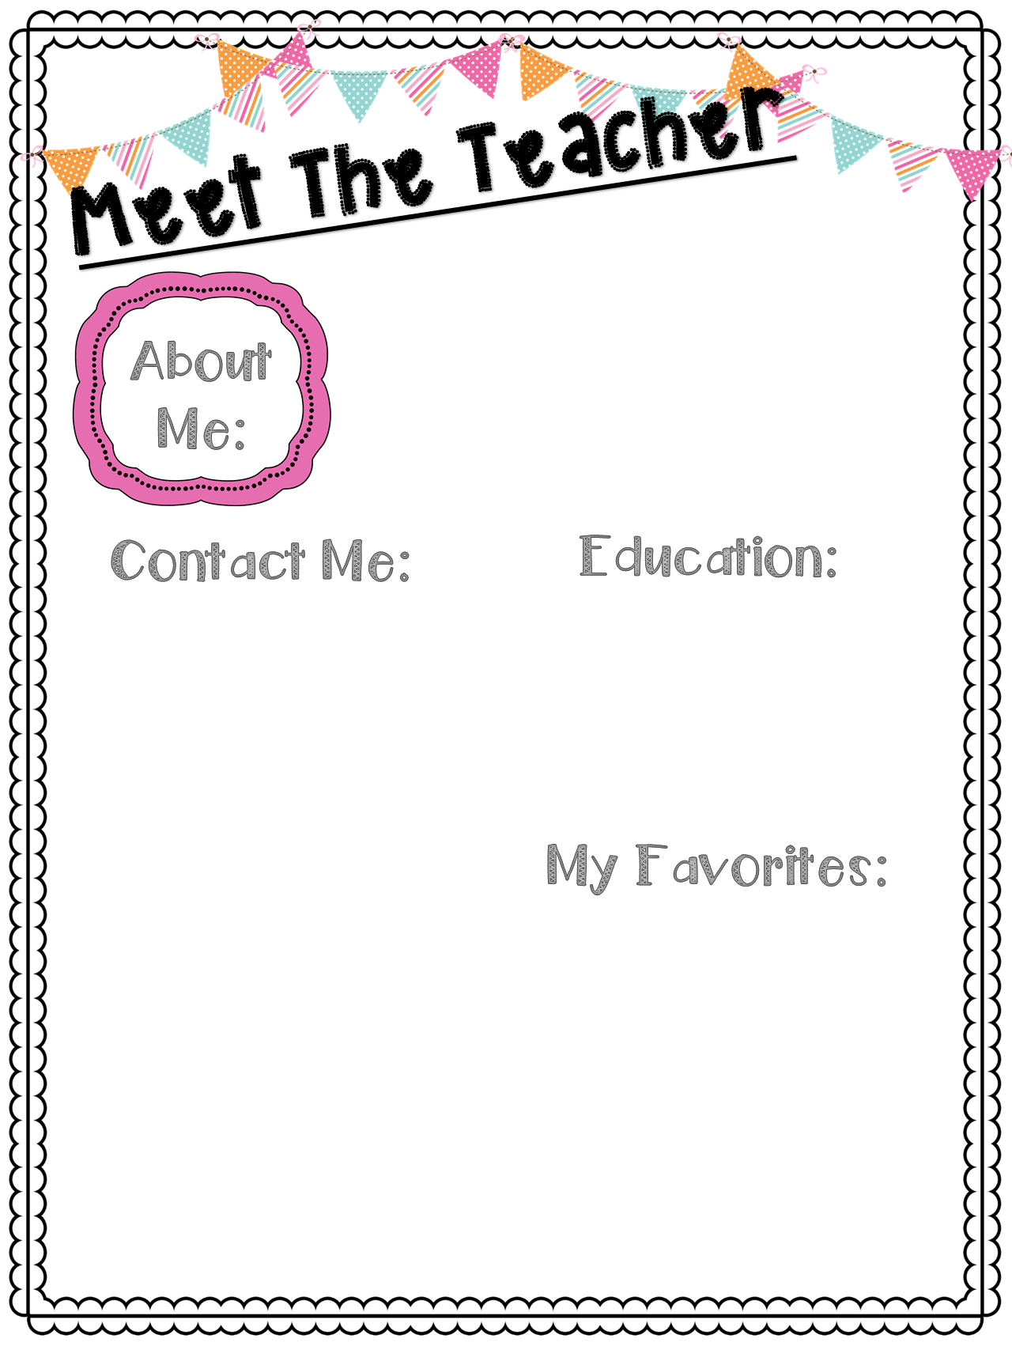
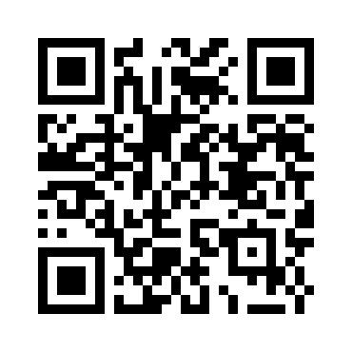
Miss Vetter
Hi, My name is Lauren Vetter. I am excited to be your teacher for the 2016-2017 school year. This will be my 1st year teaching 5th grade. I have a black lab puppy named Colt. We enjoy running and being outdoors. I also love to read, craft and go fishing. I am excited to make this the best school year yet!
I graduated with a Bachelors Degree in Education from Ferris State University. GO DAWGS!
I love to hear from parents throughout the year. Please always contact me with questions or concerns. I also love to hear from you if you are available to volunteer. ☺
Want to stay up to date with all our class happenings?
*Please scan the QR codes to access our class website. You can also visit our website by
www.vetterfifthgrade.weebly.com
lvetter@reedcity.k12.mi.us
231-832-5548 EXT 144
OPEN HOUSE
There will be an open house on Wednesday August 24th from 4:30-5:30PM. This is a great time to bring in your supplies (the list is on the back) and to meet me! I can’t wait to see you there.
Store: Target
Food: Pasta
Hobby: Arts and Crafts/Decorating
Candy: Anything Sweet
Fast Food: Panera Bread
Restaurant: Chase Creek
Drink: Hot Chocolate
Season: Fall
Sport: Football

